Slide 1



Guangren Elementary School
GRADE 1
Special Newsletter
Semester 1 Week 10: October 28 th - November 1st, 2024
光仁國小ESL雙語班特別版週報 – 一年級
第一學期第十週 十月二十八日 - 十一月一日
Contents
A peek into our week
Special acknowledgements
Birthdays of the month
Shoutouts
本週搶先看
特別焦點
本月壽星
感恩的心

Slide 2


A peek into our week
本週搶先看
Xin 1 Yellow Video Link
In the Yellow Xin 1 class, the students went on a family scavenger hunt around the room. They have to look at their worksheet and complete the sentences with the correct family members names. They had a lot of fun trying to find all the vocabulary words.
一信黃組的學生們進行了一場教室內的家庭尋寶遊戲。他們需要查看自己的學習單，並用正確的家庭成員名字完成句子。他們在尋找所有字彙的過程中玩得非常開心。
Notes:
Kira

Slide 3
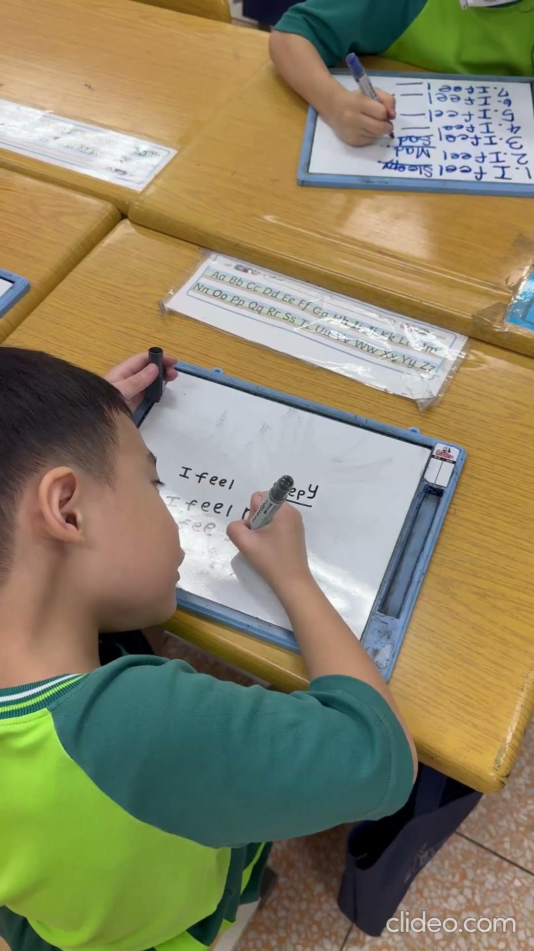
A peek into our week
本週搶先看
Xin 1 Green Video Link
In the Xin 1 Green class, students engaged in a fun writing activity focused on feelings. They looked at images displaying various emotions and then wrote sentences on their small whiteboards, ensuring they used capital letters and periods. This activity is crucial because it helps students articulate their emotions while expanding their vocabulary and practice their writing skills.
一信綠組的學生們參與了一個以情感為主題的有趣寫作活動。他們看著各種情緒的圖片，然後在小白板上寫句子，並確保使用大寫字母和句號。這項活動非常重要，因為它幫助學生表達自己的情感，同時也增加字彙並練習寫作技巧。
Notes:
Yarel

Slide 4
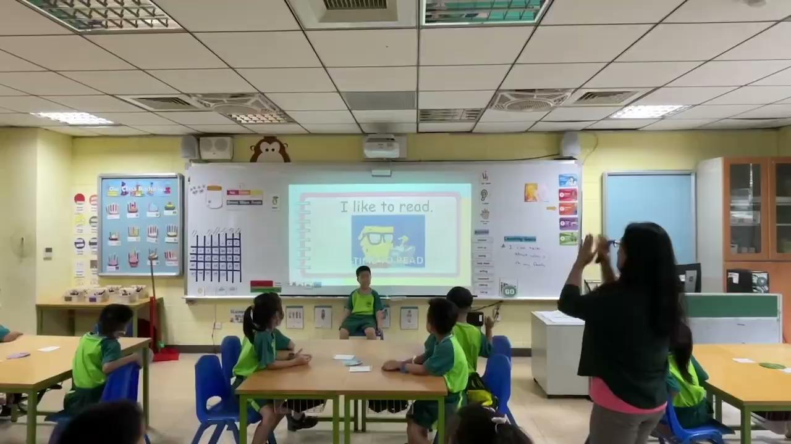
A peek into our week
本週搶先看
Ren/Ai 1 Green Video Link
In Grade 1 Green Ren and Ai class, the students practiced asking each other what they like and don’t like. Then , they played the game Hot Seat where they showed actions to the phrases “I like” and “I don’t like”. The person in the seat had to guess from their classmates actions.
一仁、一愛綠組的學生們練習了彼此詢問自己喜歡和不喜歡的事物。然後，他們玩了一個叫「Hot Seat」的遊戲，展現「我喜歡」和「我不喜歡」的動作。坐在Hot Seat 座位上的需要從同學的動作中猜出答案。
Notes:
Wendy

Slide 5
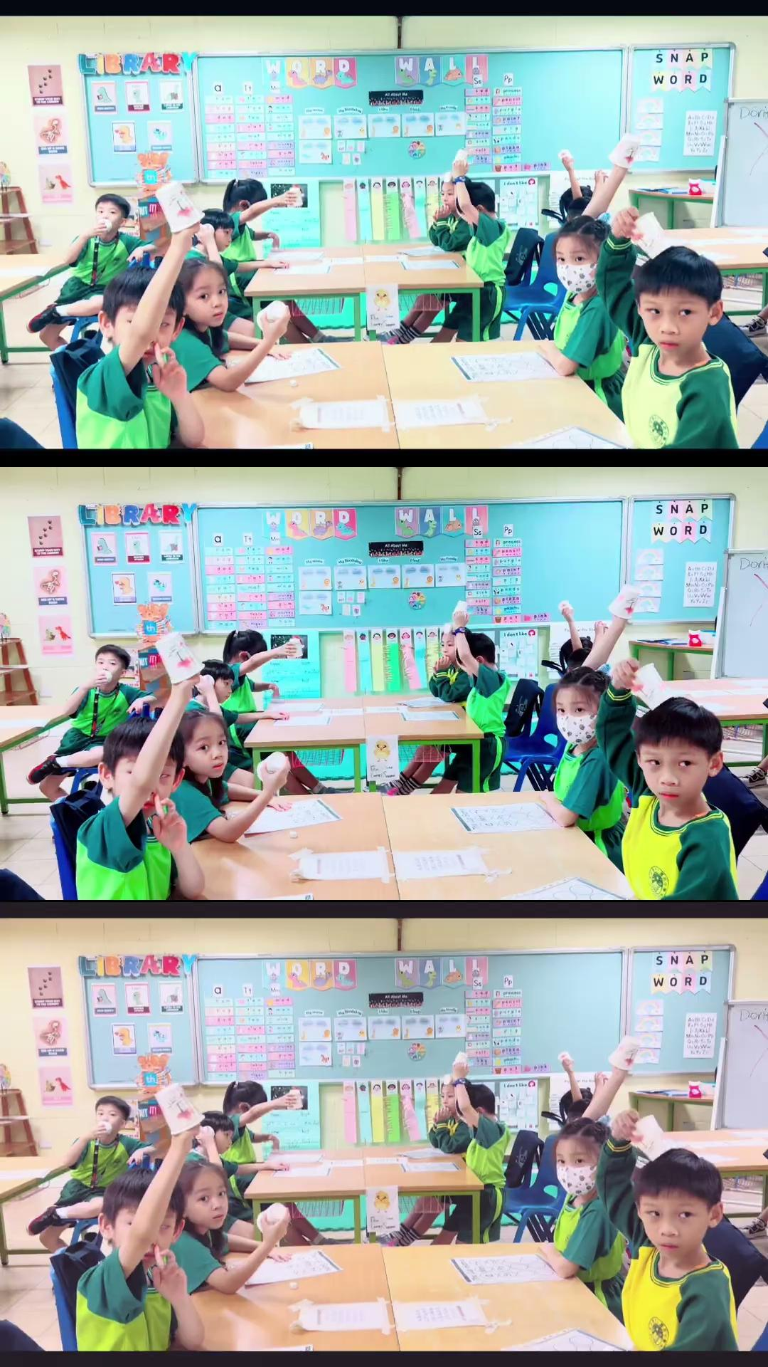
A peek into our week
本週搶先看
Ren/Ai 1 Yellow Video Link
In Ren 1 and Ai 1 Yellow Class, the students practiced phonics sounds through a cup game, improving their letter recognition, and explored words starting with the letter “Ff”. In groups, they analyzed a photo to discuss the emotions conveyed, fostering teamwork and emotional intelligence. Additionally, they drew their families and labelled each member, promoting creativity and self-expression. These activities strengthen academic skills and promote collaboration, confidence, and emotional understanding among students.
在一仁、一愛黃組，學生們透過杯子遊戲練習了拼音聲音，提升了字母辨識能力，並探討了以字母“Ff”開頭的單詞。他們分組分析一張照片，討論其中傳達的情緒，培養團隊合作和情緒智慧。此外，他們還畫了自己的家庭並標記每位成員，促進創造力和自我表達。這些活動不僅強化了學術技能，還增進了學生之間的合作、自信和情感理解。
Notes:
Nikki

Slide 6
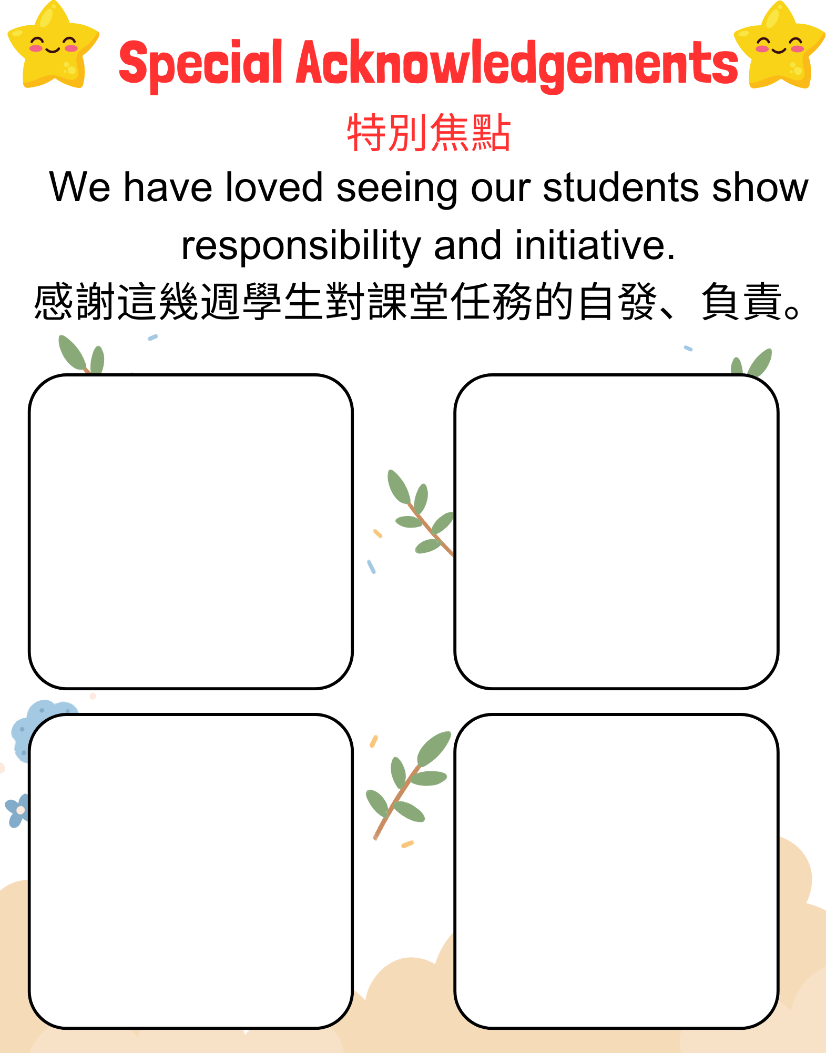
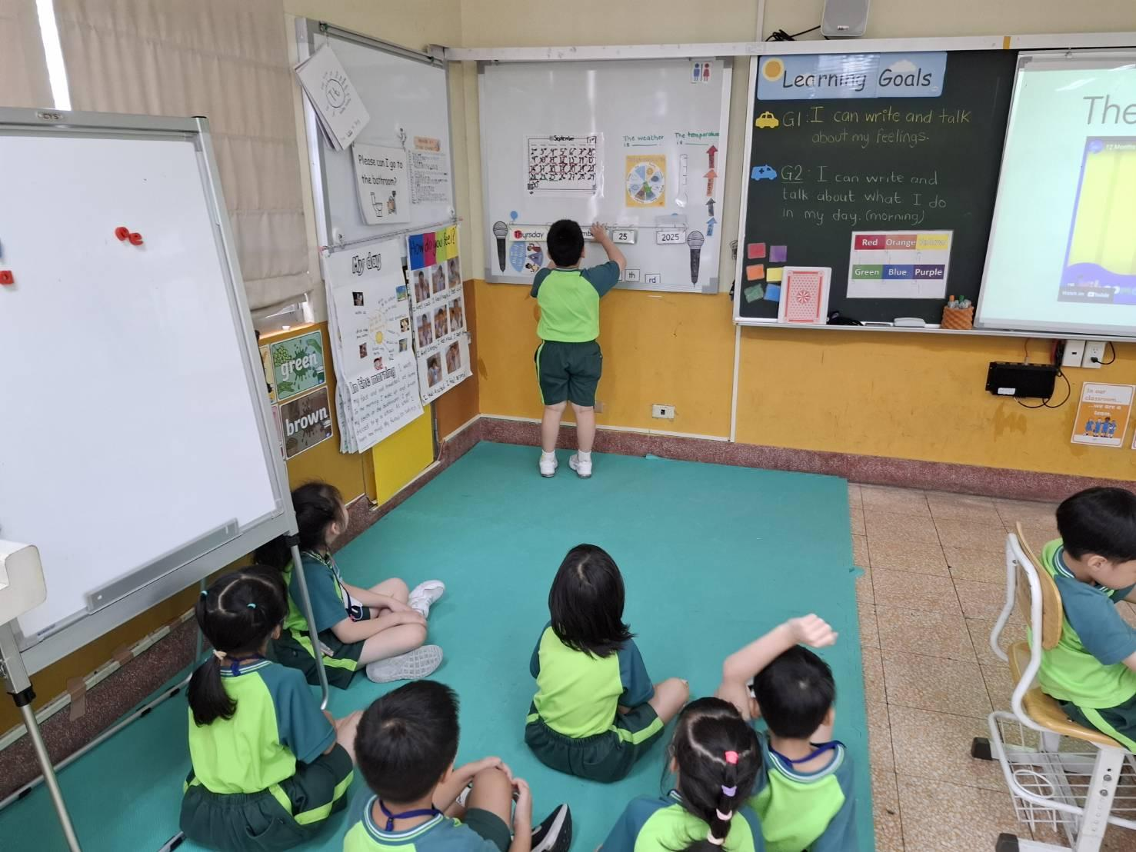
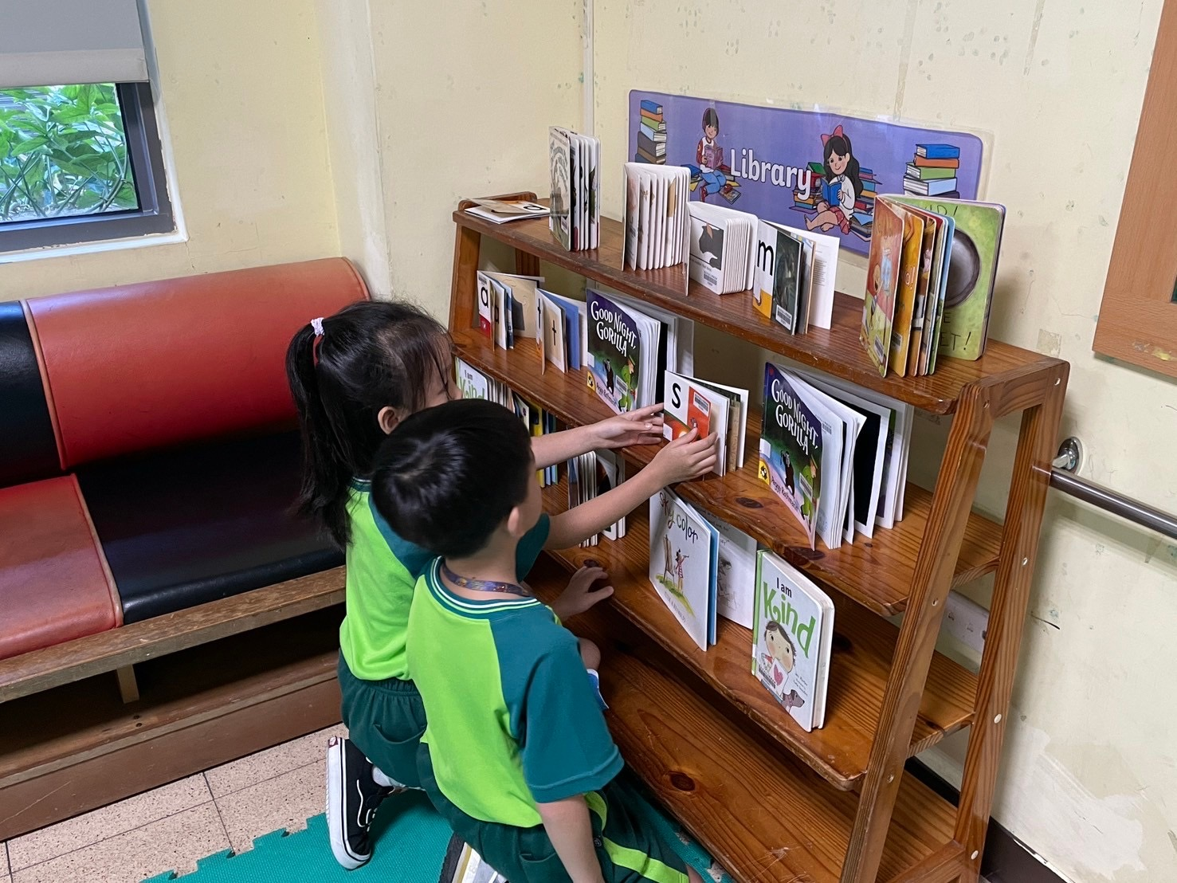
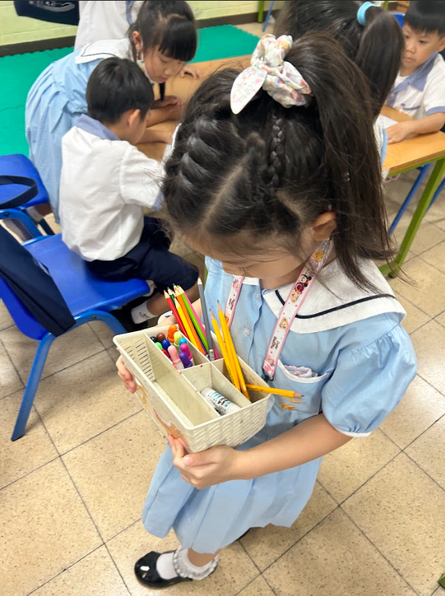
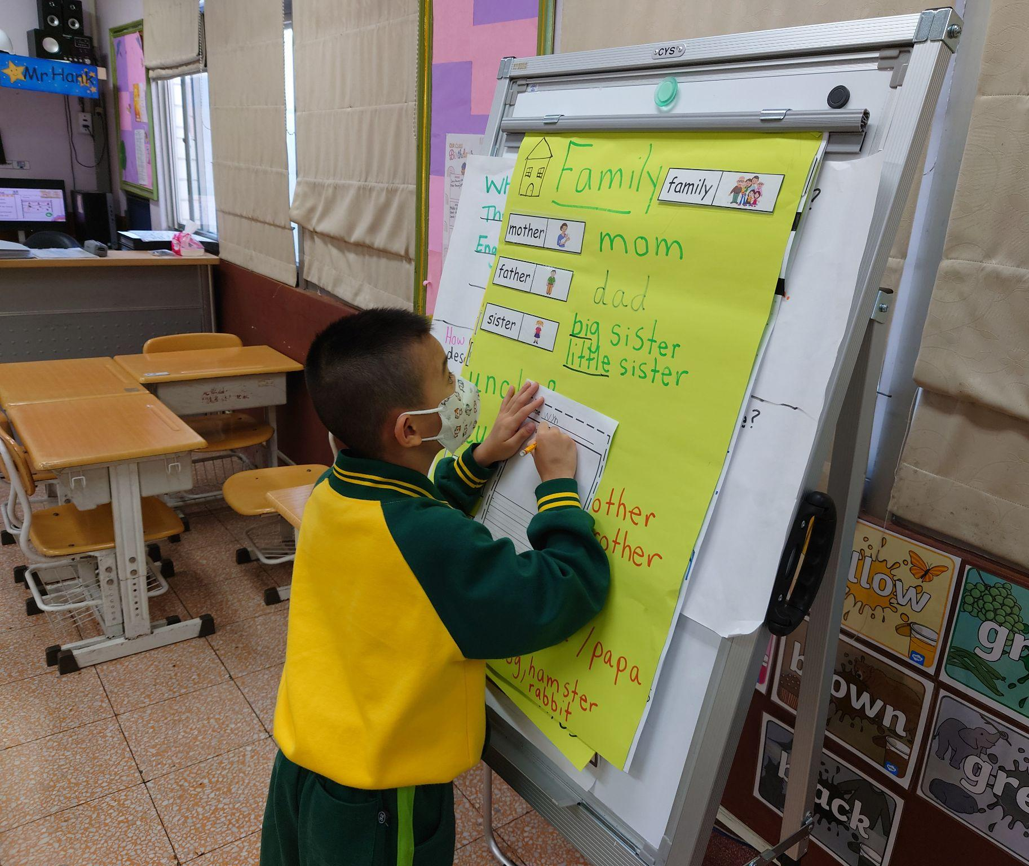

Slide 7


Birthdays of the month
Happy Birthday to you! 生日快樂!
Yellow Ai 1
一愛黃組
Chelsea
Luna
Green Ai 1
一愛綠組
Cooper
Diana H
Green Ren 1
一仁綠組
May
Jasper
Yellow Ren 1
一仁黃組
Chiara
Green Xin 1
一信綠組
Yellow Xin 1
一信黃組

Slide 8


Shoutouts
感恩的心
To our awesome EA’s, we appreciate you!
致我們最棒的EA團隊，感謝你們！

